Slide 1
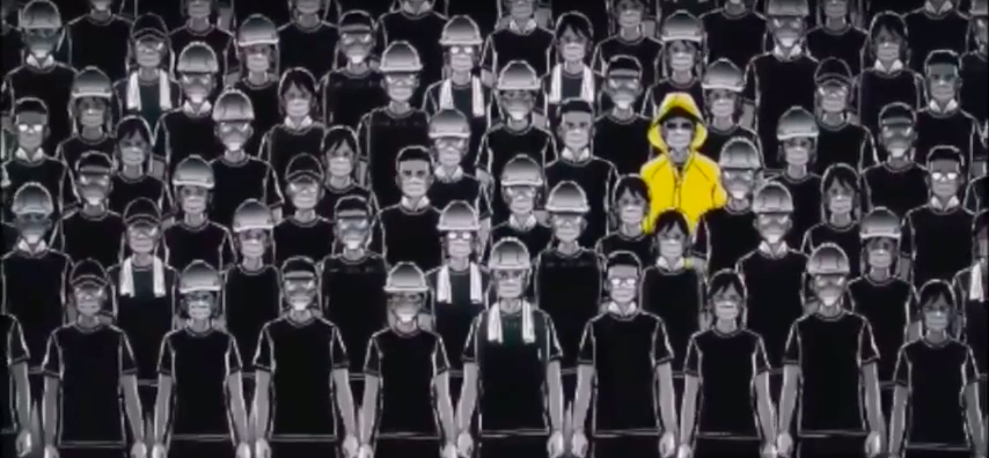
1 in 7 million: Which Hong Konger are you?
Brought to you by: Conversations with the courageous

Slide 2

Disclaimer
Please do NOT use your keyboard controls
This game is based on true events that happened in Hong Kong during the anti-extradition movement in 2019
However, the incidents may not appear in chronological order
This game contains footage of graphic violence, parental guidance is advised for minors

Slide 3
Overview:
It is 2019. You are a Hong Konger amidst the anti-extradition movement.
Civil unrest is tearing your home apart, but will it crush your moral courage as well?
How to win this game?
Don’t get badly injured, or
Don’t get arrested
Make your choices wisely

Slide 4
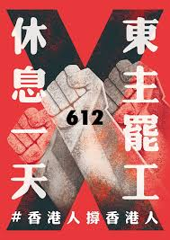
The government has been pushing the contentious extradition bill through the legislative process hastily. Many Hong Kongers are against the bill and frustrated at their government’s lack of regard for their views.
On your way to work, you see posters and flyers asking Hong Kongers to take to the streets and make their demands heard.
What do you do?
Join the protest.
Go to work, I have a mortgage to save up for!
Notes:
1: branch out into WLF or YM
object inserted

Slide 5

Ooooof - it was one long day at work, but now you’re free to go!
A friend texts you to ask if you have dinner plans - you don’t, and you haven’t met up in a while.
What would you do?
You're broke, lets just grab a quick bite from McDonald’s
Great, there’s a new restaurant in the mall you’ve been wanting to try
The city might not be safe with the protests, I think I’ll just go home.
Notes:
WLF2.0
object inserted

Slide 6

😓 TEAR GASSED 😓
While chomping down on a Big Mac, your eyes start tearing up, your throat stings and you start coughing. But that wasn’t the hot sauce...
It’s the police’s tear gas leaking in through the AC system! Luckily, first aiders are around to help you deal with the discomfort. All the food in the restaurant has to be scrapped due to tear gas exposure.
What’s next?
Notes:
WLF2.1

Slide 7
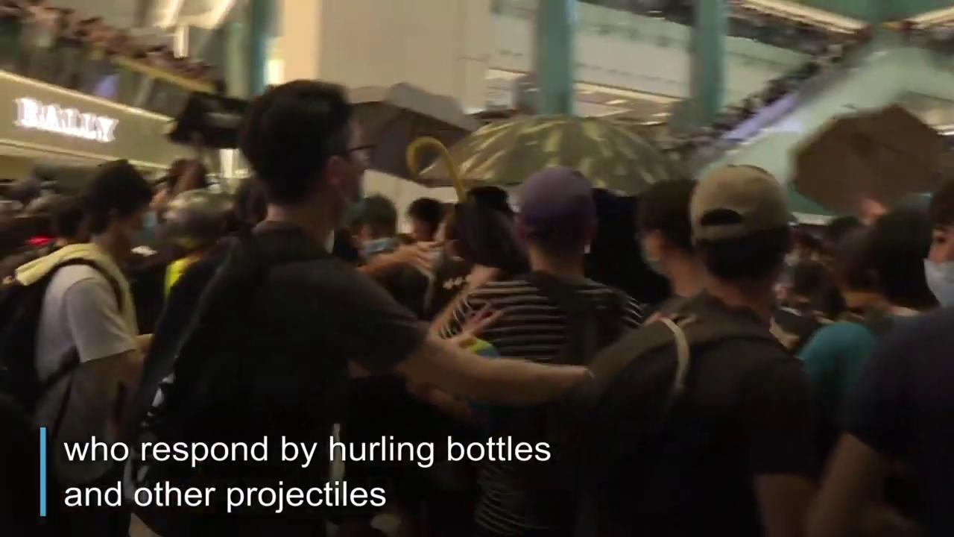

💀 SEVERELY INJURED 💀
You decide to browse for a bit in the mall after your overpriced meal. You panic when crowds of protestors and ordinary shoppers start running in your direction.
They are followed by riot police wielding batons and closing in on those who straggle behind. Some protestors start fighting back. Amidst the chaos, you are seriously injured and sent to hospital.
TRY AGAIN
Notes:
WLF2.2

Slide 8
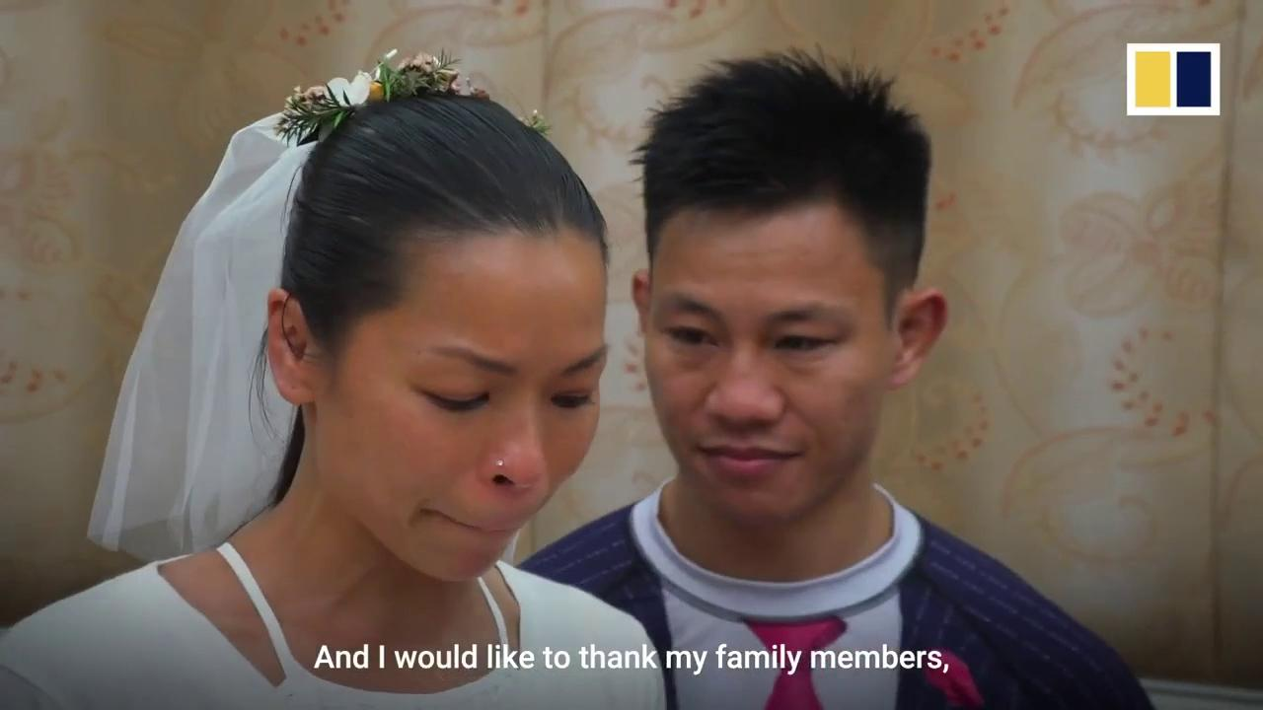
💀 ARRESTED 💀
You call your fiance so that you can go home together. Hurrying down the street, you hear sounds of yelling, running, and gunshots. Ahead of you, a young woman in black trips and falls. You bend down to help, but before she struggles to her feet, the riot police have arrested all three of you.
You and your fiance are among the 44 people charged with riot on July 28, a few days before your wedding. You decide to marry each other on bail- even 10 years of jail time cannot separate the two of you.
TRY AGAIN
Notes:
WLF2.3 footage of citic tower? citic tower?

Slide 9

WELL, that didn’t really help you de-stress from work at all...
At least it’s over and it’s time to go.
How do you want to get home?
Taxi - I need to get away from this craziness quick!
MTR (subway), it’s what I ride every day.
I think I’ll take a walk first to calm my nerves
Notes:
WLF3.0

Slide 10
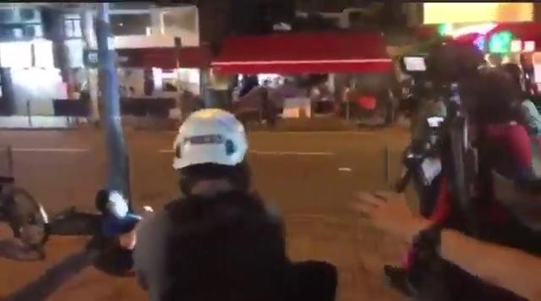
😓 HURT BY POLICE😓
You head towards the street, ready to flag down a taxi, except you see a group of riot police heading over. You slow, in case they become suspicious of you, and even hold your hands up. “ Where can I flag a taxi?”, you ask. An officer approaches and pushes you to the ground
What’s next?

Slide 11
💀 INJURED & TRAUMATISED 💀
*Beep* Goes your Octopus card as you enter the gates. You go down the escalators, across the platform...you’ve been on the MTR so many times in your life, you’re on autopilot. You put in your earphones for some music - except all of sudden, you hear screaming -
You are indiscriminately attacked by police, heavily injured, sent to hospital and now require long-term psychological therapy.
TRY AGAIN
Notes:
WLF3.2

Slide 12
You stroll down bustling streets lit with neon lights. Many protestors in black are heading home too, exhausted from another day on the street. Some of them are soaking wet from being in the rain.
Suddenly, two men in black push a third, younger man to the ground. At first you are alarmed of citizens attacking others on a busy street.
But WAIT, they have handcuffs...you realise they are police disguised as protestors...
You gotta say something, this is not right!
Better not attract attention to yourself - look away and leave.
Notes:
WLF3.3

Slide 13
💀 INJURED & ARRESTED 💀
“You’ve lost your conscience/morals!” you yell at the police from across the street.
Several policemen chase you down the street and beat you with their batons, only stopping when journalists arrive with their cameras.
You have injuries in your head, jaw, shoulder and are arrested.
TRY AGAIN

Slide 14

You’re starting to feel frustrated with the government’s indifference to the social unrest, and how the police is adding fuel to the fire.
You aren’t sure how to get involved though...
I’ll just express my views on Facebook and get that frustration off my chest.
Never mind. That presentation at work is coming up, I need to focus on that because my promotion is on the line.
I’ll go volunteer at a Lennon Wall. Nothing radical about buying markers and post-it notes, right?
Notes:
WLF4.0

Slide 15
💀 FIRED FROM JOB 💀
Your supervisors ask to meet with you at work. They have seen your Facebook statuses, and decided to fire you.
You are not alone. Other colleagues were barred from working in mainland China due to their social media activities.
TRY AGAIN
Notes:
WLF4.1

Slide 16
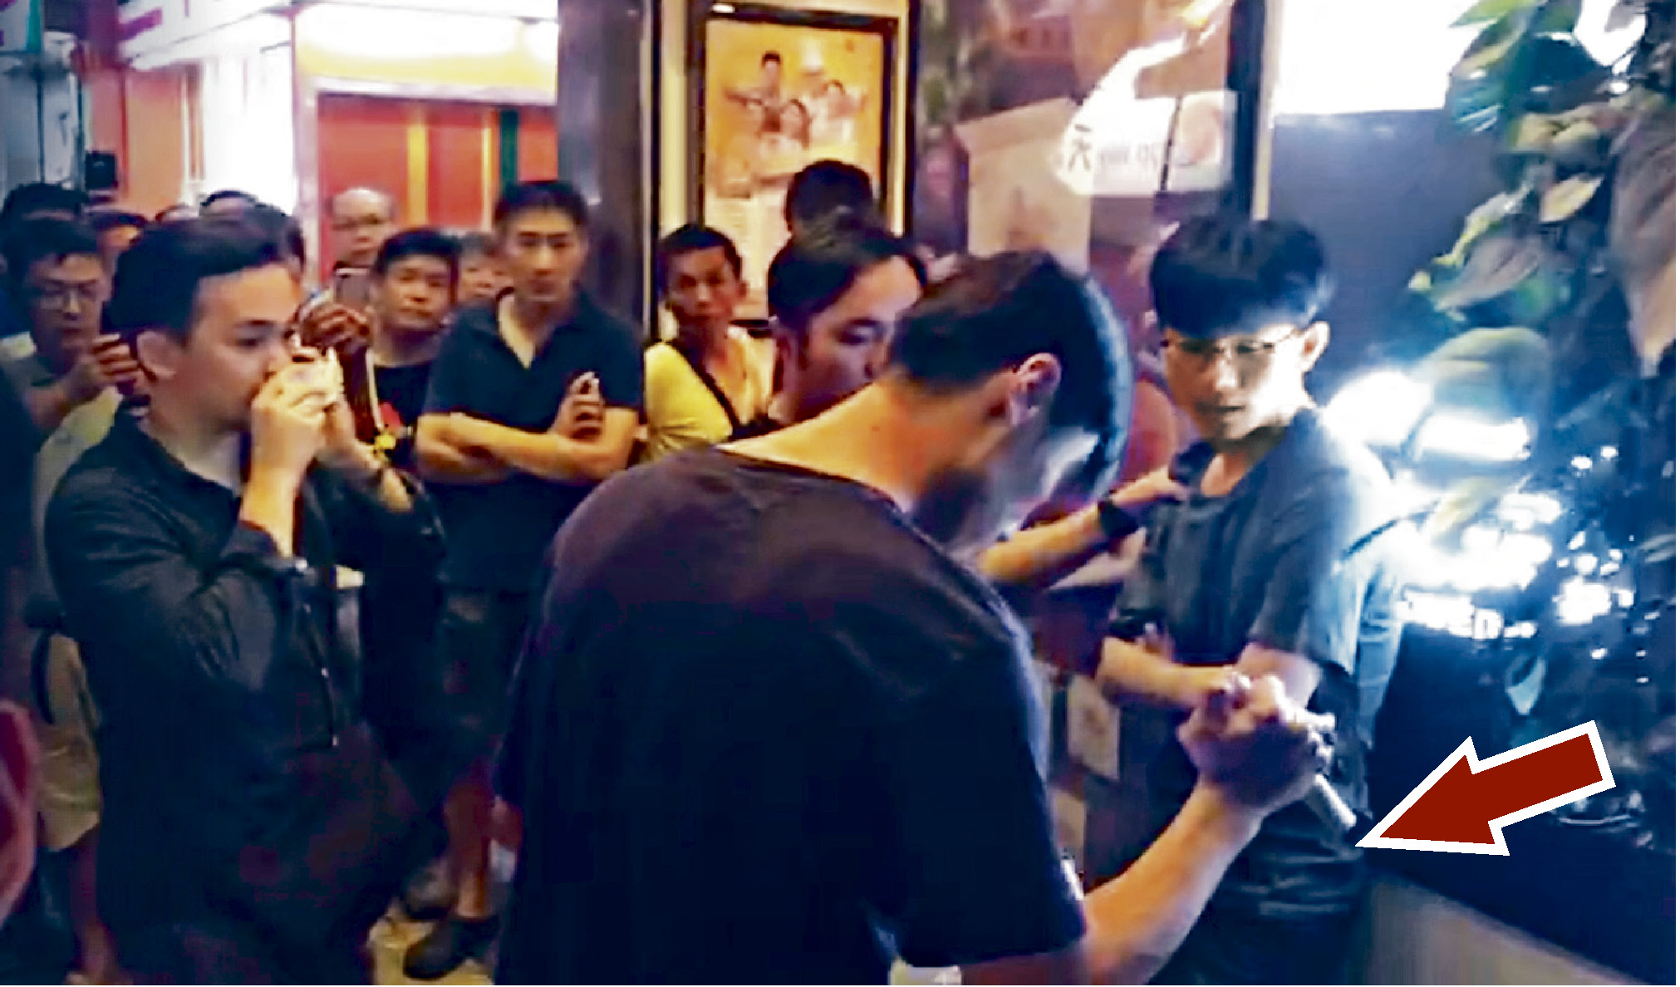
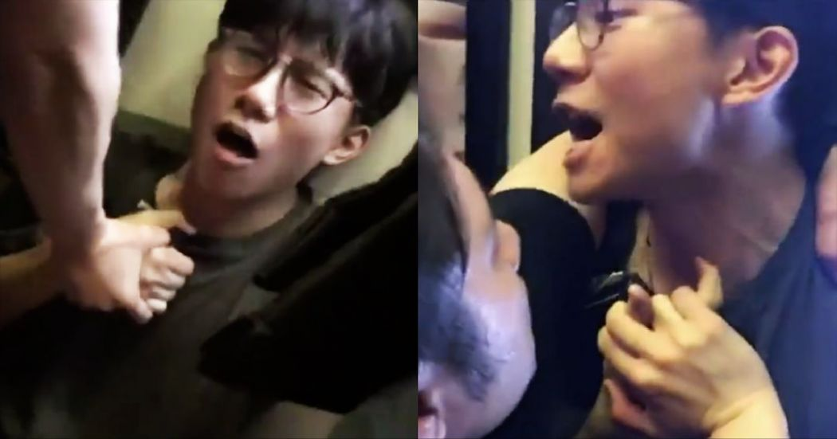
You are stopped and searched by plainclothes police. They find a laser pen you are planning to use for your presentation and declare it a “lethal weapon”.
You are arrested but released on bail.
😓 That was close! 😓
Notes:
WLF4.2:

Slide 17
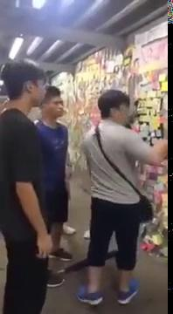
💀 BADLY INJURED 💀
You stock up on post-it notes, markers, tape and some posters and take them to a Lennon Wall in your neighborhood with 2 friends. Unfortunately…
A man tears down post-it notes from the wall, and when you stand in front of him to shield the wall. He hits you, at least 10 times. You get up after each blow, and continue to stand without fighting back (but you are actually trained in Taekwondo!) . Passersby stop and one calls the police.
TRY AGAIN
Notes:
WLF4.3

Slide 18

You can’t bear the tension that pervades Hong Kong anymore. You see police and feel an irrational fear of being arrested, even though you’ve done nothing wrong.
Every morning, you agonize over what color to wear, because your default - black - may attract attacks from triad members or stop-and-search by policemen.
You never thought you’d ever want to escape from this home, but maybe a break would help you feel better. Where to?
Japan - that’s your favorite place to travel.
Shenzhen - affordable just a train ride away across the Chinese border
Your religious community. That is always a place to find peace.
Notes:
WLF5.0

Slide 19
To your dismay, your flight to Japan has been canceled due to the mass strikes at the airport.
To make things worse, you also realize you’ve lost your phone. You hurry back to the restroom to check if you’ve left it there...
Mistreated by the police again. What’s next? 😓
Notes:
WLF5.1

Slide 20
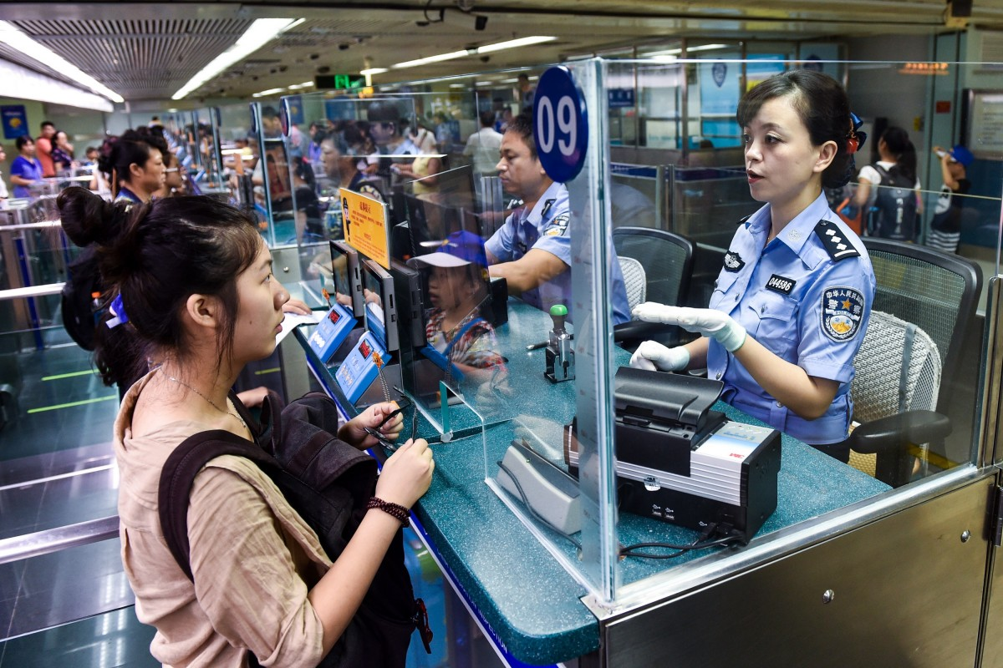
At the mainland Chinese border, the immigration officer checks your phone. She finds photos of protests and other related posts on social media.
You are:
detained for 8 hours,
photographed,
force to provide your DNA,
released only after you write a letter of assurance stating that you will not participate in protests again.
Here goes your privacy. 😓
Notes:
WLF5.2

Slide 21
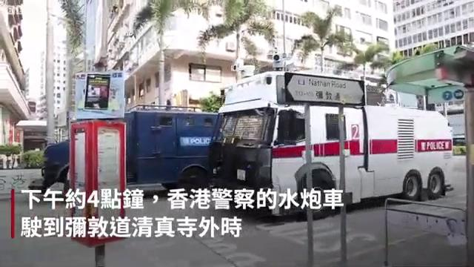
You gather with a small group of people from your religious community, outside your place of worship. Many of you are also ethnic minorities in Hong Kong. At this moment, a police vehicle with a water cannon passes by and blasts the 10 of you with dyed, blue water mixed with pepper spray.
This is met with outrage from HongKongers across cultural and ethnic divides. A group of them volunteer to clean the building.
This is
TRY AGAIN
Notes:
WLF5.2

Slide 22

Protests are happening all across Hong Kong, in response to the ban on masks that was enacted overnight by emergency law. You hurry home after work every day, lest you get stranded by the MTR (subway) that shuts down at the busiest hours per police orders.
Tonight however, you are sick, have not seen the doctor, and have no medicine at home. What do you do?
Go out with a face mask on. You don’t want any more germs OR oppression of your rights.
Go out without a face mask. You have nothing to hide. Don’t want to be seens as a “rioter” either.
Stay home, it’s too dangerous to go out after dark. I would rather get sicker than...
Notes:
WLF6.0

Slide 23
💀 SEIZED BY POLICE 💀
On the way you pass a group of police and one immediately yells at you to produce a “doctor’s note” to prove its legal for you to wear a mask.
You explain your situation, and also voice your discontent with such oppression from the government. You are seized immediately, surrounded by police and pressed against an iron fence....
You walk through your neighborhood with a face mask on.
TRY AGAIN
Notes:
WLF6.1

Slide 24
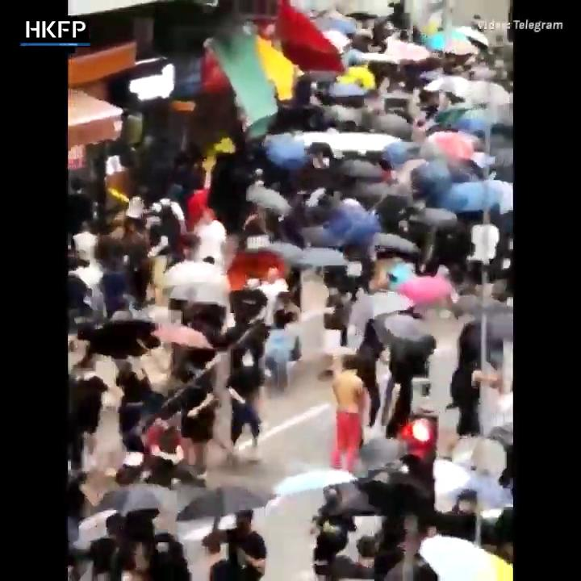
💀 YOUR LEGS FRACTURED 💀
You hurry to the pharmacy, taking the most crowded street possible - surely that’s the safest? A taxi suddenly ploughs through the crowd and into you, breaking your legs.
Protestors tried to do you justice by beating up this taxi driver. But guess what? This driver will receive over $660K USD in donations from a pro-communist organization for his actions. You will be charged with rioting, and possibly be disabled forever.
TRY AGAIN
Notes:
WLF6.2

Slide 25
Congratulations!
You have survived for now, by...
giving up your freedom to wearing a mask
not protesting, not going out
self-censoring on social media
turning a blind eye to fellow citizen needing help
Even if you tolerate all of the above, the government, police and pro-communist people can still disrupt your life whenever they want.
You survived, yes, but is this how you want to live?
¯\_(ツ)_/¯
Notes:
WLF6.3

Slide 26

Alright. Time to get ready for the protest.
What would you wear / bring?
I’ll just bring my wallet, keys, phone, and a bottle of water.
Let me pick up a box of bottled water for other protestors. They might get thirsty
You gotta be prepared for the worst! Hard hat, gas mask, safety goggles, and umbrella.

Slide 27
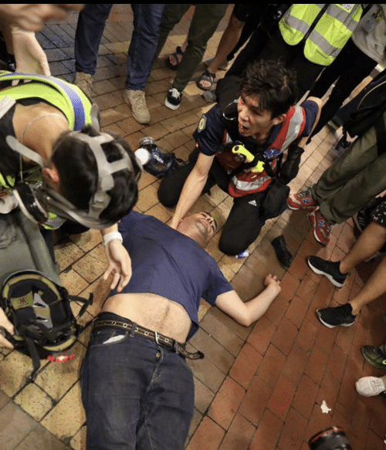
You go to the peaceful protest area outside CITIC Tower, to watch a live broadcast of the protests near the Legislative Council.
Suddenly, tear gas is fired from both sides, cornering the crowd. As more tear gas grenades rain down into the middle of the crowd, people push towards the building, only to be pressed by the surging crowd against locked doors.
Your eyes water, your throat burns and your airway clamp shut.
“Asthma inhaler! We need an inhaler NOW!” screams the protestor next to you, catching you as you collapse…luckily somebody passes their inhaler through the crowd and you are saved. 😓
Notes:
WLF7.1

Slide 28
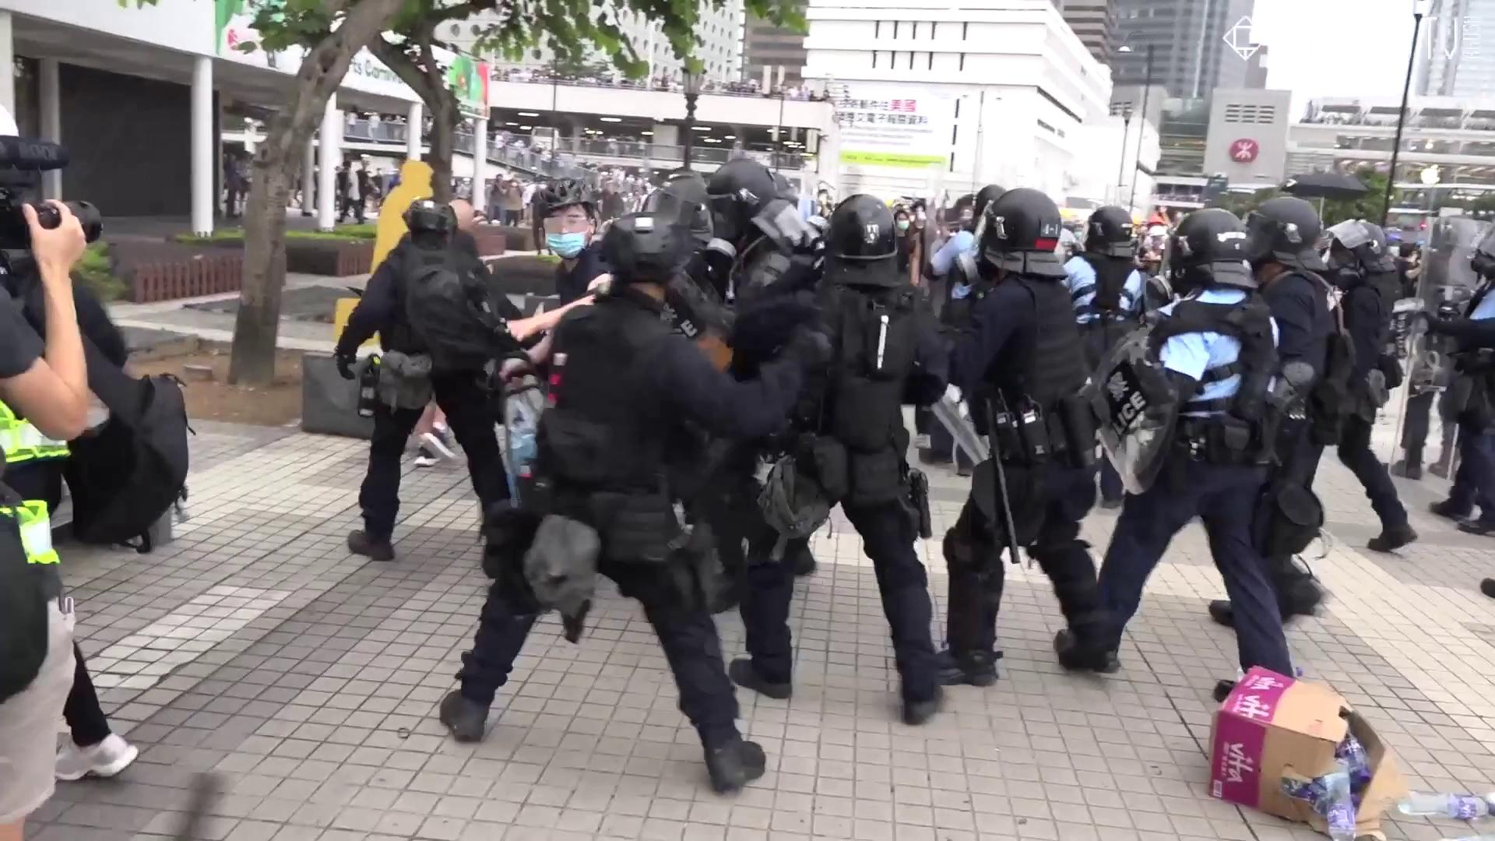
💀 ARRESTED 💀
You buy a box of bottled water near the protest site, and start hauling it towards one of the “resource centers”, where donated water, snacks and other supplies are redistributed.
A group of police man rush over, surround you, and began hitting you with their batons. You try to walk around them, but are eventually pushed to the ground and arrested.
TRY AGAIN
Notes:
WLF7.2

Slide 29
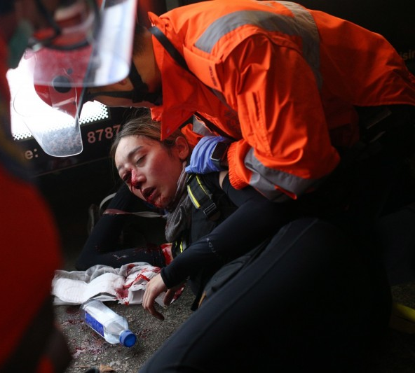
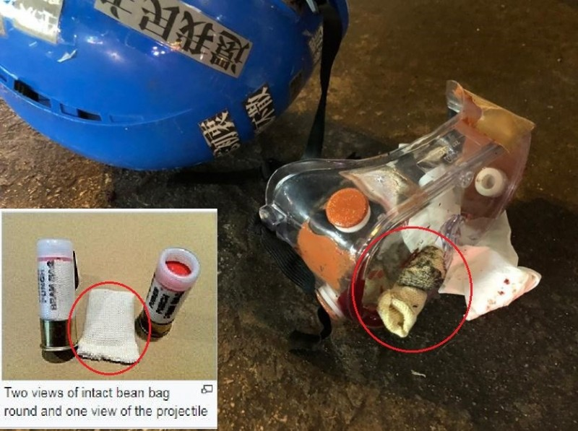
💀 GOT SHOT AND BLINDED 💀
You move closer to the frontline, telling yourself you will be fine with your protective gear. You are wrong.
You are shot in your right eye by riot police, permanent damaging to your vision. Others, including a journalist, will be blinded in the following weeks.
And the police will attempt to deny their responsibility, despite photos of a bean bag round piercing your safety goggles.
Notes:
WLF7.3 but you will not be scared into silence. In the coming days, you will speak to the media about your ordeal, and call again for an independent inquiry into police violence.

Slide 30
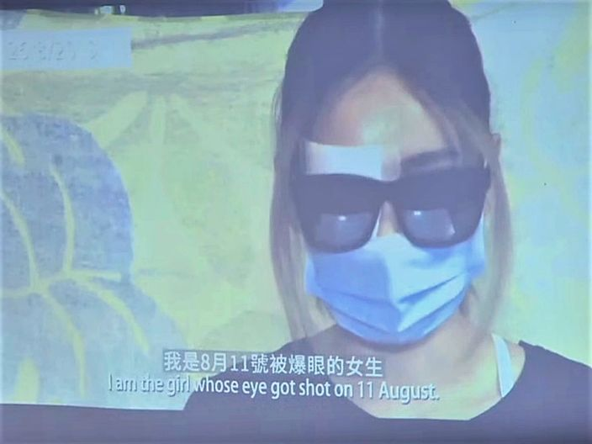
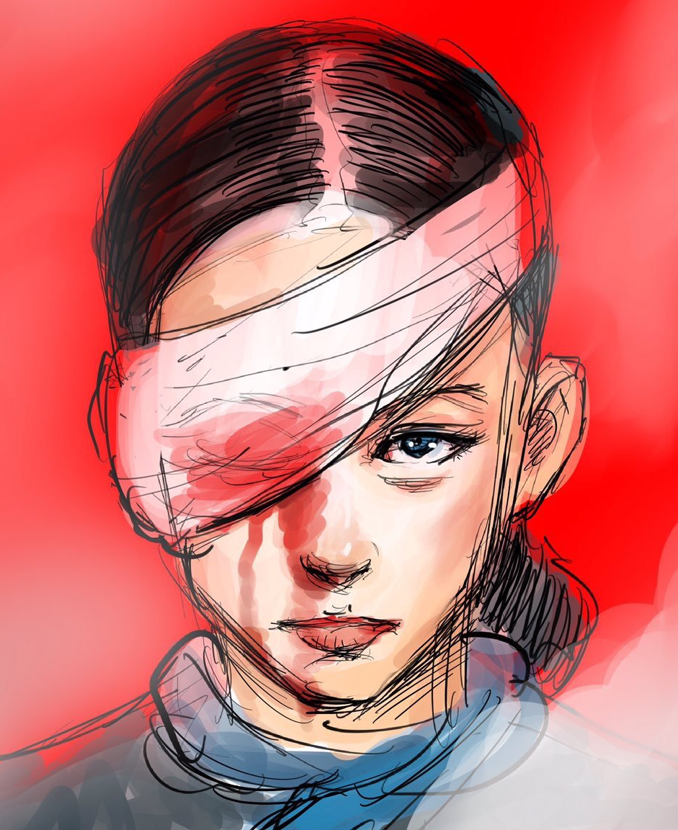
💀 GOT SHOT AND BLINDED 💀
But you will not be scared into silence. In the coming days, you will speak to the media about your ordeal, and call again for an independent inquiry into police violence.
OR
TRY AGAIN
JUMP TO ENDING
Notes:
WLF7.3

Slide 31
You are shaken by what you have experienced and want to get home. Your clothes are soaked with pepper spray, so you are grateful for the clothes people have left at the subway station for protestors.
However, the subway station itself has been shut down per police orders. A stranger shows up and starts asking if anybody needs a ride home, what do you do?
Take the bus
Walk to the next MTR (subway) station and take the subway there.
Catch a ride from the stranger
Notes:
WLF7.3 final message

Slide 32
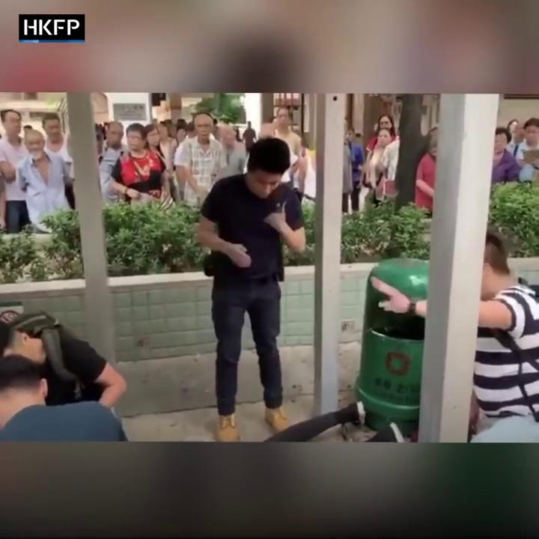
💀 ARRESTED 💀
After a long wait (some roads are blocked by barricades, and others closed off by police), you get on the bus. To your dismay, at the next stop, some men drag you and some other young people off. You can only assume they are plainclothes policemen because they refuse to show any ID. You are arrested despite the protests of surrounding citizens...
TRY AGAIN

Slide 33
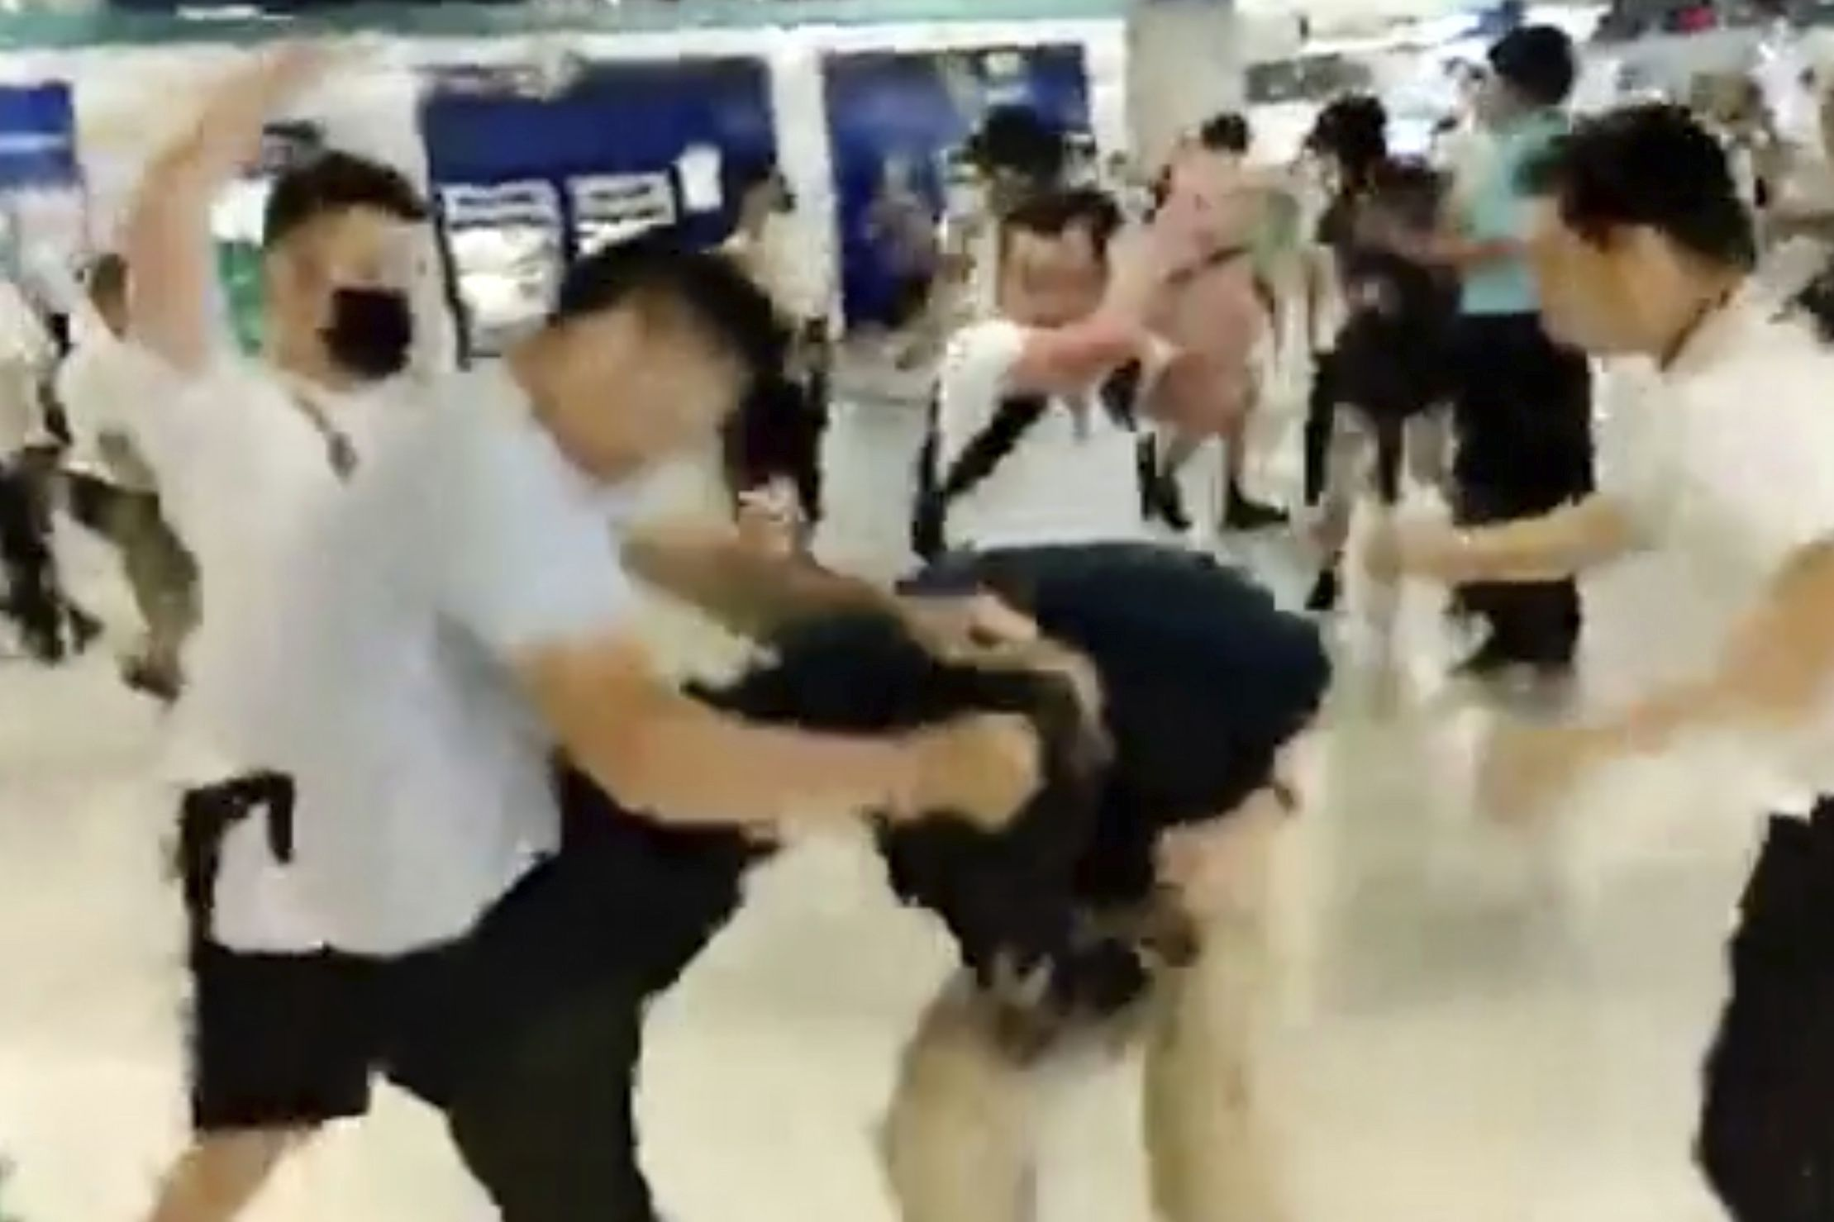
💀 HEAVILY INJURED 💀
A mob of men in white t-shirts storm Yuen Long MTR station and indiscriminately attack commuters with iron and bamboo rods, including pregnant woman and children...
Your calls to the police go unanswered. Two police officers show up but walk away, and a larger team of police do not reappear until 39 minutes later, when the white shirted men have temporarily left. Once the police leave, the white-shirted men reappear, as if choreographed. You are among the 45 people injured on this night.
TRY AGAIN

Slide 34
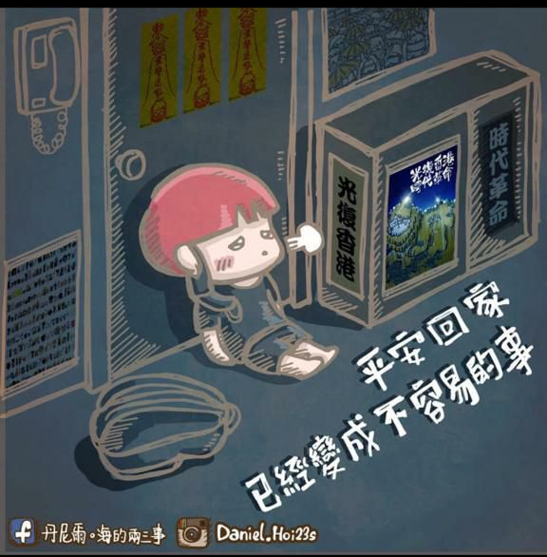
You hop on the stranger’s car with a few other protestors, hoping that he is not an undercover police officer. In his car, you each get change of clothes and food, your first meal in the past 12 hours.
You throw your old clothes away, afraid that your parents will notice and worry, or worse, that you will be identified by police.

Slide 35
Over the next days, you recover from your first encounter with riot police. Your initial fear is replaced with indignance when, after the first of multiple suicides of protestors in despair, a march of 2 million, and mounting police brutality the Chief Executive insists on pushing the bill forward, labels the protests a “riot” and utters not a word of condolence for the injured or deceased. You decide to do something...
I will volunteer at a Lennon Wall.
I will protest at the airport, so that international audiences are made aware of this
I will protest at the tax offices, to obstruct the functioning of the government
Notes:
WLF7.3 final message

Slide 36
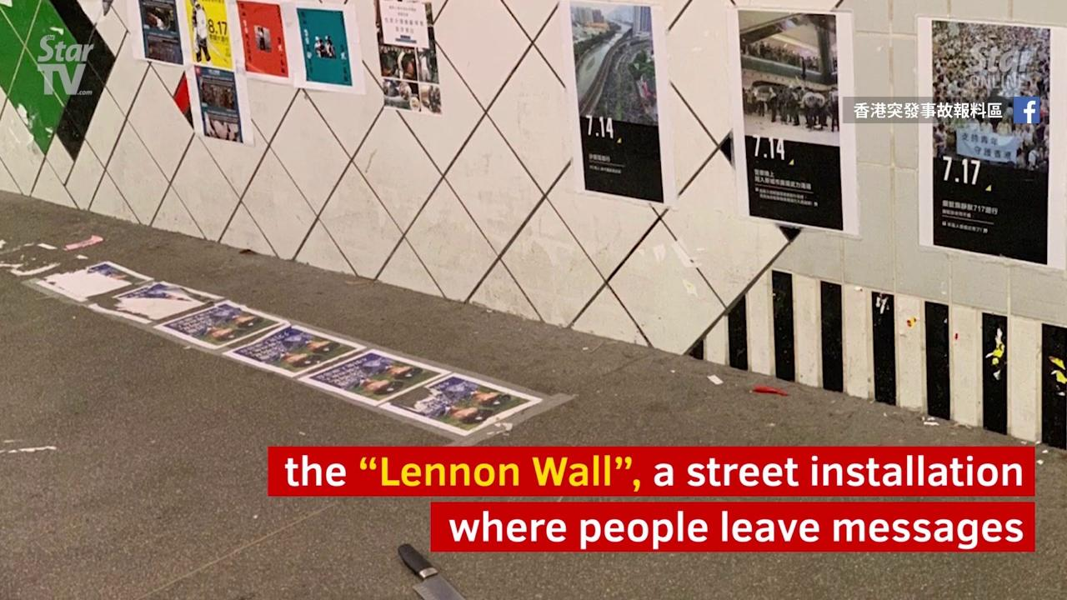
💀 STABBED, IN ICU 💀
You head down to the Lennon Wall with post-it notes and markers.
A man with a cleaver stabs you. You are taken to the intensive care unit.
Your neighbors, not trusting the police, take thorough investigation into their hands. They block the building the aggressor escaped to, discover his clothes, and demand the police to pull security camera footage. Only by doing this could the aggressor be arrested and do you justice.
TRY AGAIN
Notes:
The police arrive after he has left and take his cleaver as evidence.

Slide 37
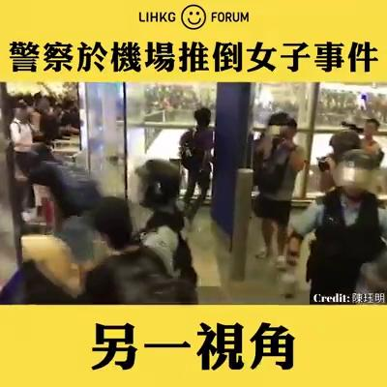
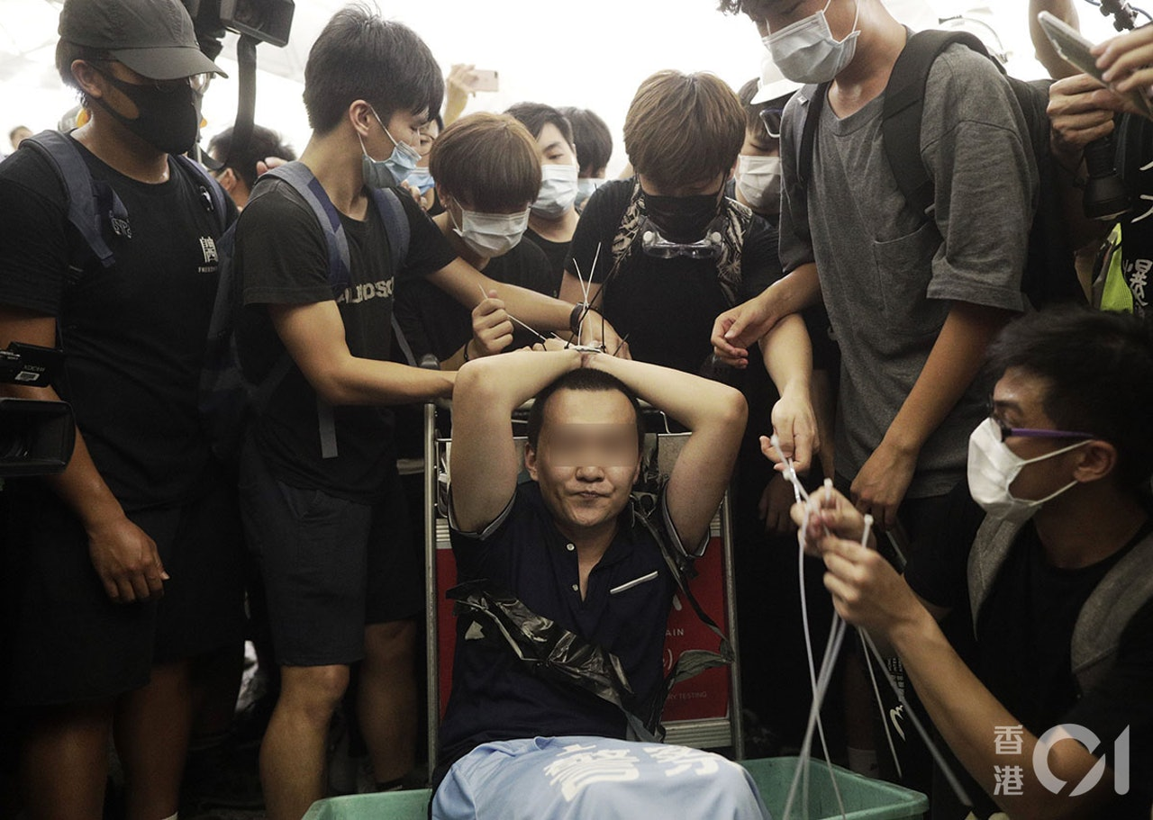
💀 ARRESTED 💀
Protestors, wary of “ghosts” (police disguised as protestors who instigate violence or arrest actual protestors), become suspicious when a mainland Chinese man claiming to be a reporter does not show any reporter’s ID. They find a blue “Support HK Police” tee shirt in his bag and tie him up.
Police then arrested many protestors, including you.
TRY AGAIN

Slide 38
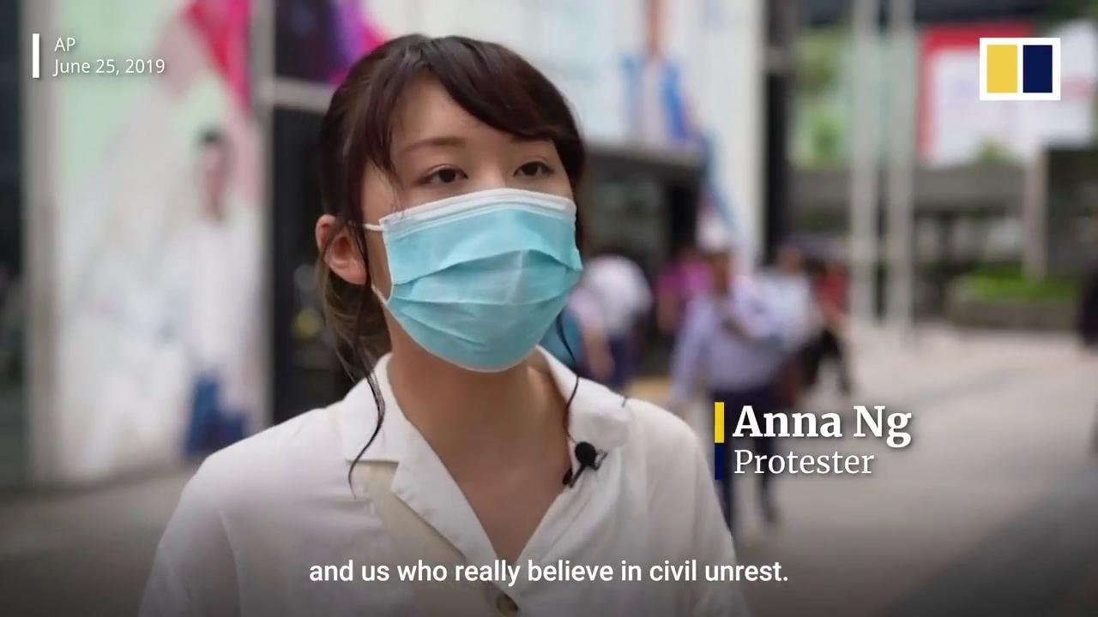

Slide 39
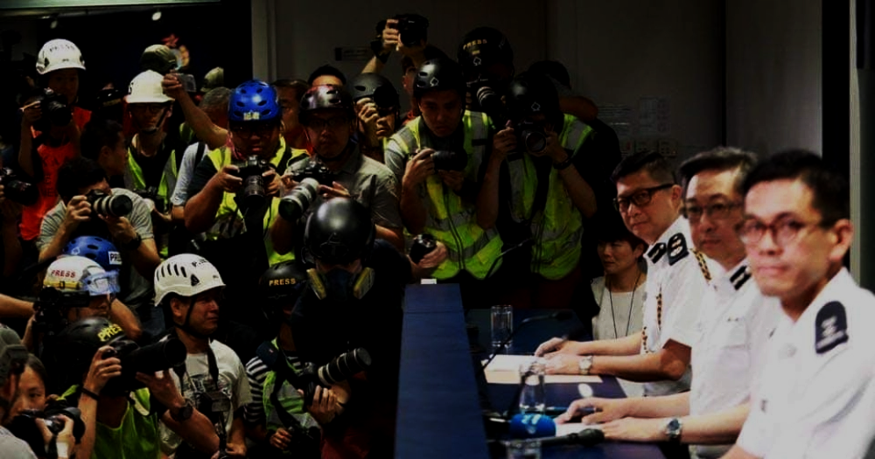
Weeks pass, and still the people’s demands go unheeded. What's worse - the government and police began daily press conferences to spread disinformation war against the protestors.
Reporters now wear protective gear to protest police brutality and lies. What would you do to show solidarity?
I will volunteer as a first aider. There are many injured who don’t seek medical help for fear of arrest at hospitals.
I will join the frontliners. I cannot let them fight for my freedom for me.
I will join “Protect the Children”, wearing a yellow vest to keep peace between young people and police
Notes:
WLF7.3 final message

Slide 40
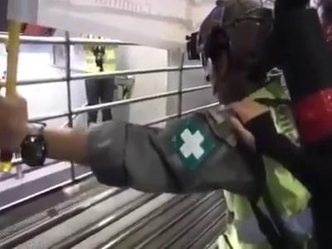
💀 ARRESTED 💀
You receive news that the police are beating up commuters inside Prince Edward Subway Station. You arrive at the scene after running several miles, but police refuse to let you in.
You peek through the locked gates at the commuters bleeding and/or lying unconscious on the ground and beg the police frantically. Nobody comes. Later, you are arrested and charged with riot.
TRY AGAIN

Slide 41
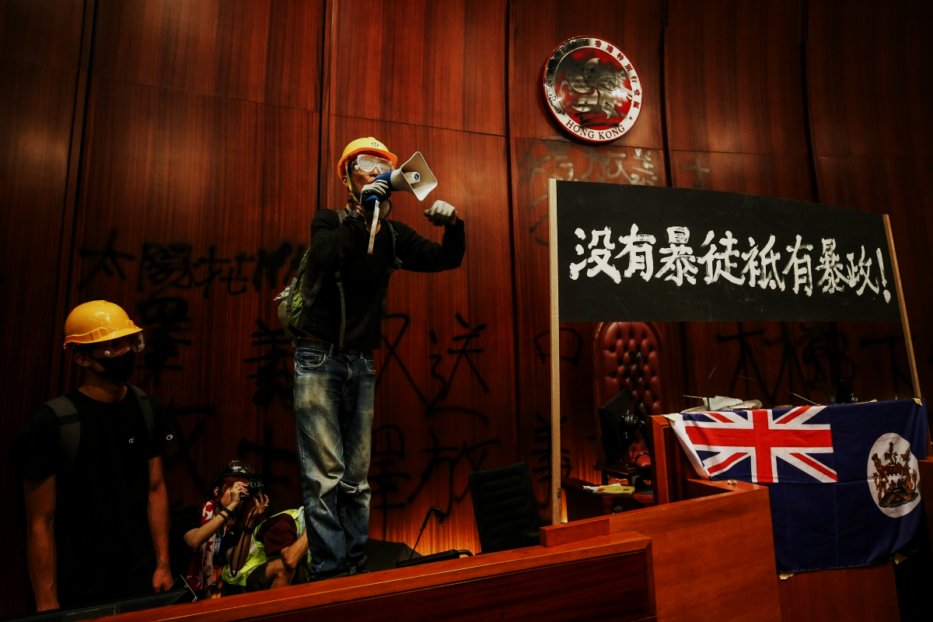
You and other protestors break into the Legislative Council. Your goal is clear - you will only vandalize objects symbolizing the tyrannical regime - portraits of pro-communist legislators and the emblem of Hong Kong. You protect all historical artifacts, and you graffiti “You taught me peaceful protest is useless” on the pillars of the meeting room.
As mid-night draws near, protestors escape, but a small number want to stay until the riot police come. What will you do?
I will stay until the end. I’d rather face the police than give up democracy and justice.
Time to go. There are more battles for you to fight tomorrow.

Slide 42
Ten minutes before midnight, when the riot police are rumored to take action against all those still in LegCo - only journalists and the few protestors who were determined to stay wait in the meeting room. The tension in the air is palpable...
Suddenly, a group of protestors return, shouting “we come together, we leave together!” and carry their companions out to safety.

Slide 43
💀 BEATEN UP LIKE AN OBJECT 💀
While shielding the youngsters at the frontline, you are seized by the police and taken to a back alley. There, they surround you and beat you up.
The police insist that the video shows them kicking “a yellow object”, and that whomever accuses them of abusing a person should identify themselves for “further investigation”.
TRY AGAIN

Slide 44
The bad news does not stop. In fact, it gets more personal - the 3rd grader you tutor every Friday was arrested for yelling a protest slogan. Your aunt calls you, hysterical, because your niece, who has been protesting, never came home from school. 750 of the 2300+ arrests that have happened in the past months are of people under 18.
I’ll help organize protests and rallies in my neighborhood.
I’m going back to the frontline. This is war against an entire generation, how dare they touch our kids!
I’ll join the students forming human chains protesting police brutality.
Notes:
WLF7.3 final message

Slide 45
💀 ARRESTED 💀
You and a group of friends apply for a permit to protest in your neighborhood. However, your application is denied and you group does not receive a Letter of No Objection. That means any protesting would be illegal.
You decide to march alone, but announce to the public that the protest is canceled, to protect them from legal liability. Tens of thousands of citizens join you on the march anyway, and you are arrested the next day.
TRY AGAIN

Slide 46
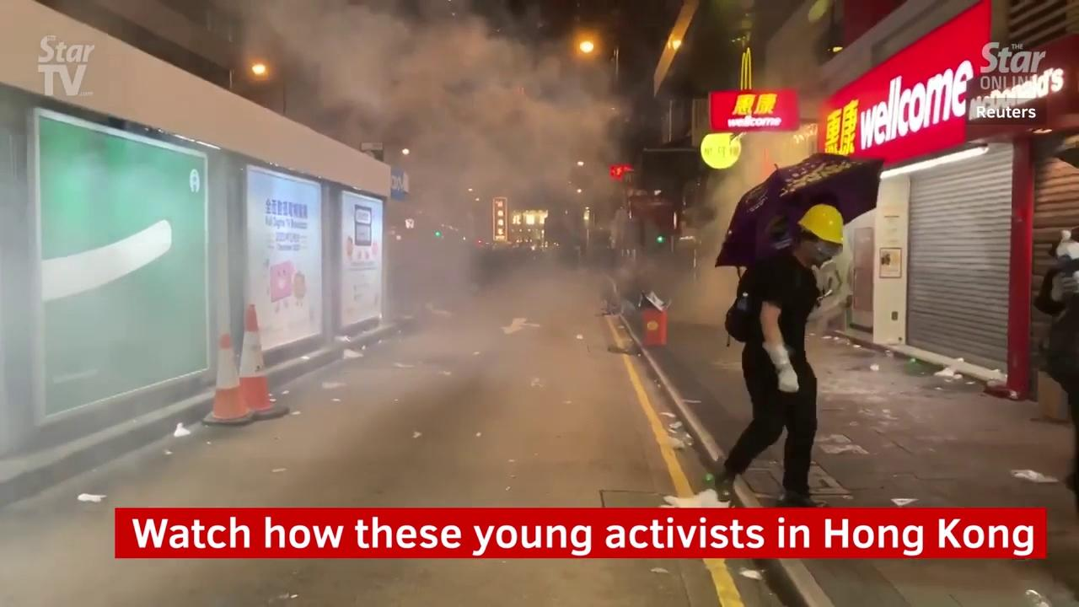
You are careful this time. To protest your identity, you wrap your ID card in foil, buy one-way MTR tickets rather than your own Octopus card, you disable face and fingerprint detection on your phone. You cover your entire face behind a gas mask, helmet, safety goggles. The police fire 800 tear gas rounds within a day, and you and a team of other protestors dash towards, rather than away from them, to put them out.

Slide 47
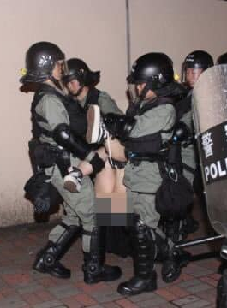
💀 SEXUALLY ABUSED / RAPED 💀
Unfortunately you don’t run fast enough. The riot police seize you, removing your clothing forcefully while carrying you away.
You are detained in a pitch black cell, strip searched as officers of the opposite sex look on and jeer, and then physically and sexually abused.

Slide 48
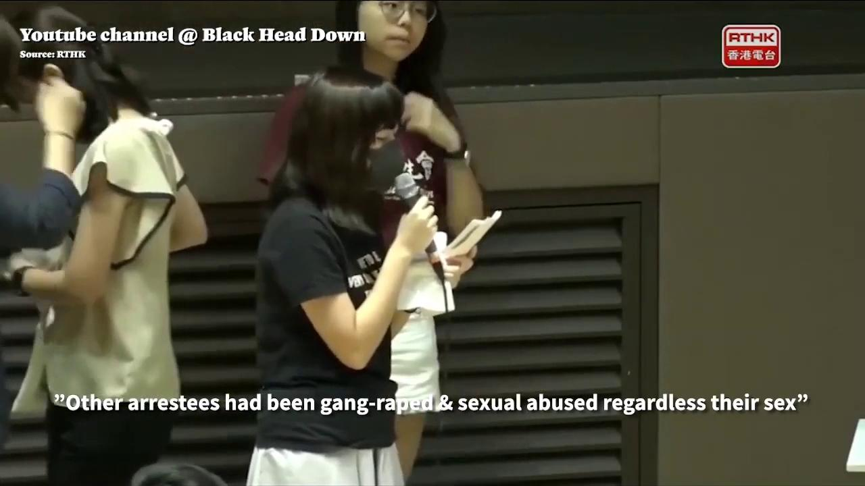
💀 SEXUALLY ABUSED / RAPED 💀
But you will not be scared into silence. In the coming days, you find the courage to speak up and tell your story..
OR
TRY AGAIN
JUMP TO ENDING

Slide 49
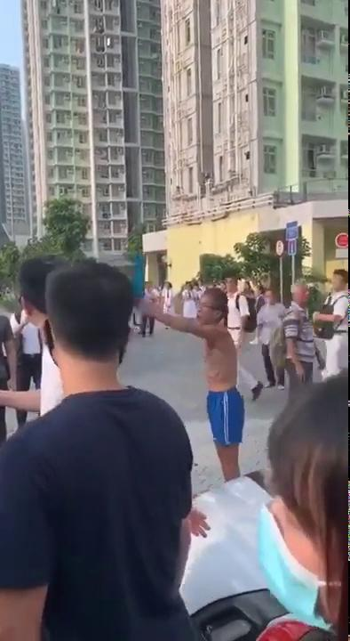
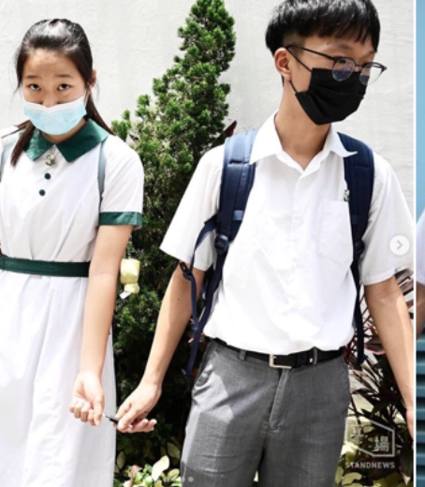
You return to your high school. Who knew that the anti-extradition movement would spark a high school reunion? The students hold hands and stretch for miles and miles. You smile for the first time in a long while when you see that a boy and girl have decide to hold the ends of a pen so they don’t have to hold hands.
There is a commotion nearby, and you see an angry man brandishes a cutter at a group of students. You go up to help, and am jabbed in the arm.
oh well it’s just the arm... 😓

Slide 50
After the violent clashes between police and civilians after the anti-mask law, some protesters call for a “day of rest”, so they will recover and focus on garnering international support.
What would you do?
There’s no resting. I’m heading to the frontline again. I don’t know what will happen, so I wrote a will and left it at home.
You have started coughing up blood and may have broken something from a fall while running from riot police. Go to a public hospital
I’ll just take a stroll around, without my mask...
Notes:
WLF7.3 final message

Slide 51
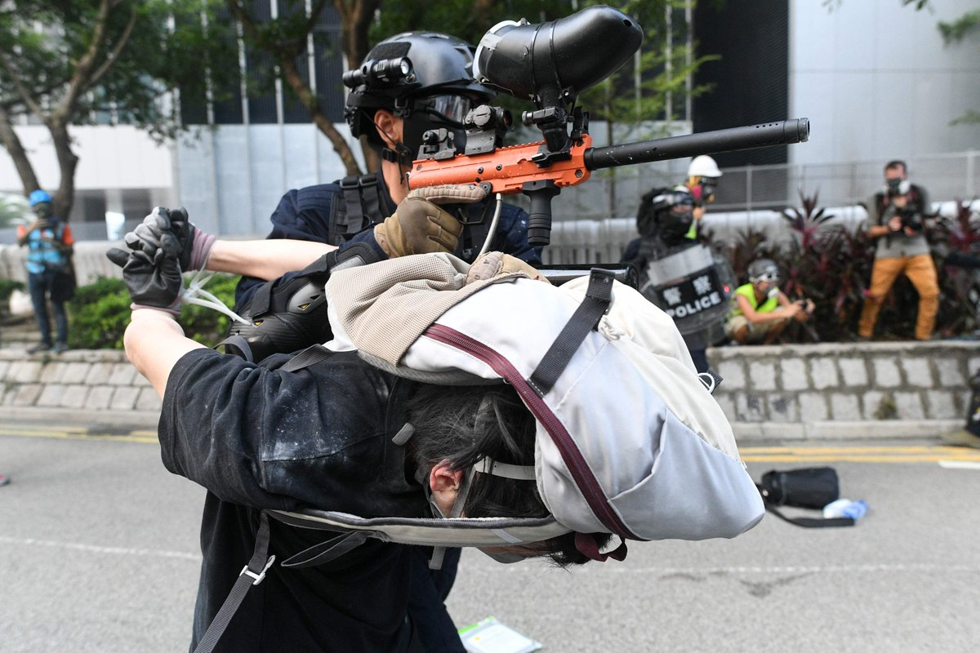
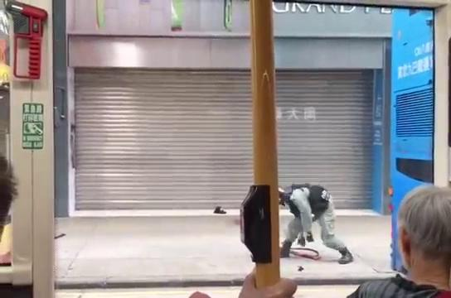
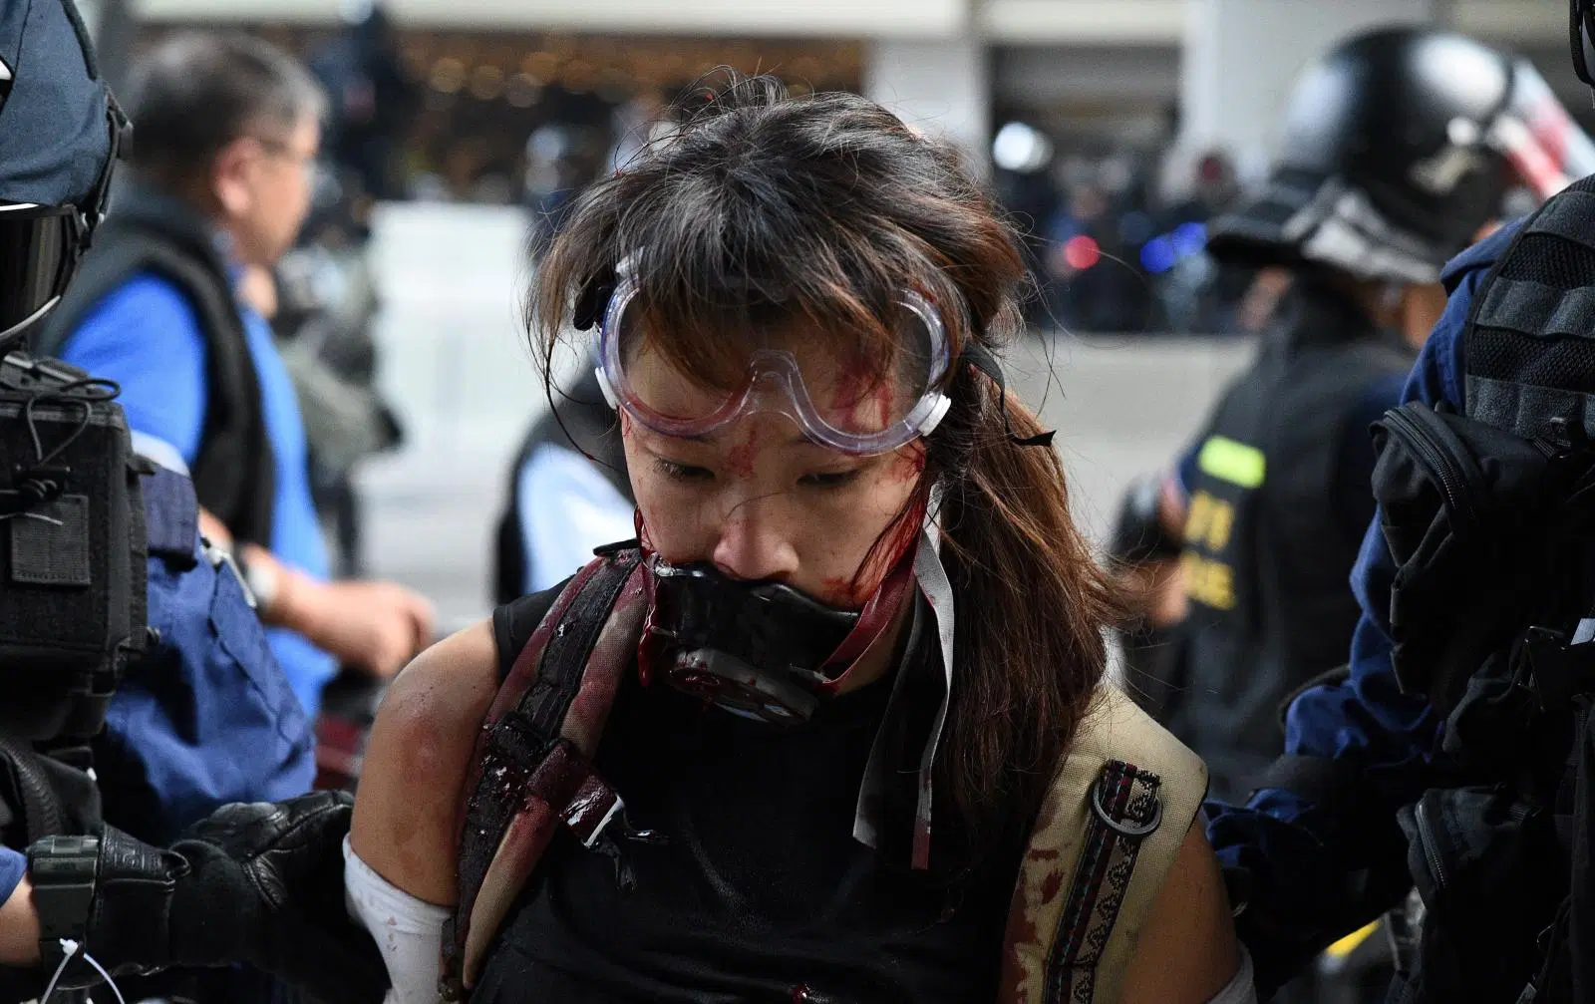
💀ARRESTED 💀
While running from the riot police, you notice one of your fellow frontliners stragglin behind. You and some other frontliners save them, but are eventually arrested.
TRY AGAIN

Slide 52
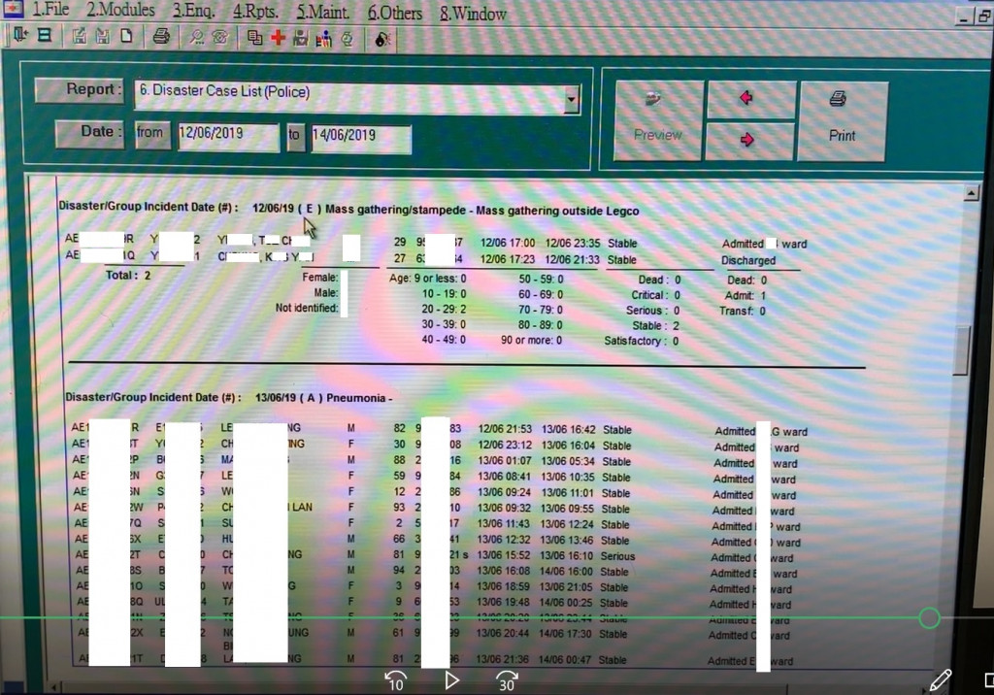
💀 ARRESTED 💀
When you arrive at the public hospital, police are there arresting people with “suspicious conditions” that result from their crowd control weapons.
It turns out that the Hospital Authority told medical staff to label patients “Mass gathering outside Legco” and identify them as “police,” “reporter,” “civilian,” or “others.”
You are flagged down by police because of your symptoms and arrested.
TRY AGAIN

Slide 53
You were merely trying to take a stroll in your neighborhood, but get caught up in a throng of protestors running from teargas.
As you run beneath a pedestrian overpass, you narrowly dodge a trash can thrown down by police above you. Others in the crowd scream bullets rain down from above.
eh at least you didn’t die 😓

Slide 54
4 months into the protest, your home has changed forever. Nothing you have tried seems to get your demands through to the government.
What else can you do?
Vandalize mainland Chinese businesses who slandered protestors.
Participate as a candidate in the district council election next month.
I will continue to go to the frontline and face the police head-on.
Notes:
WLF7.3 final message

Slide 55
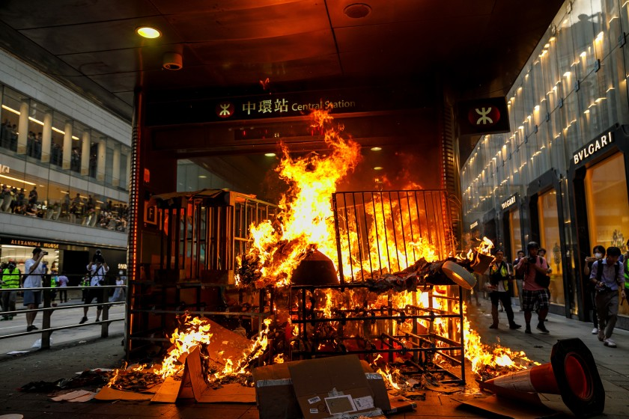
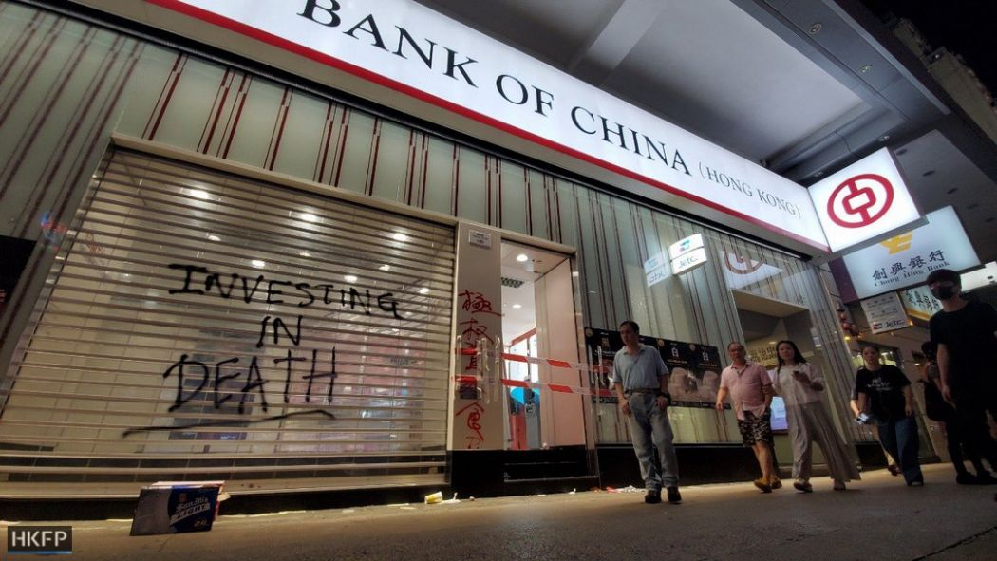
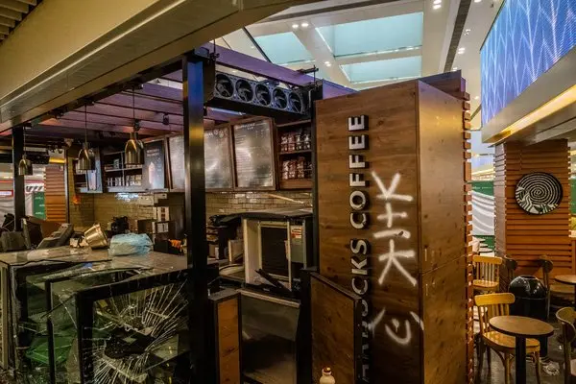
Fires are started, windows are smashed, and many shops, banks and subway stations are shut across the city. This is met with heated discussion even within pro-democracy public, and some urge others to scale back vandalism so as not to lose international support, or give the Chief Executive an excuse to delay local district council elections next month.

Slide 56
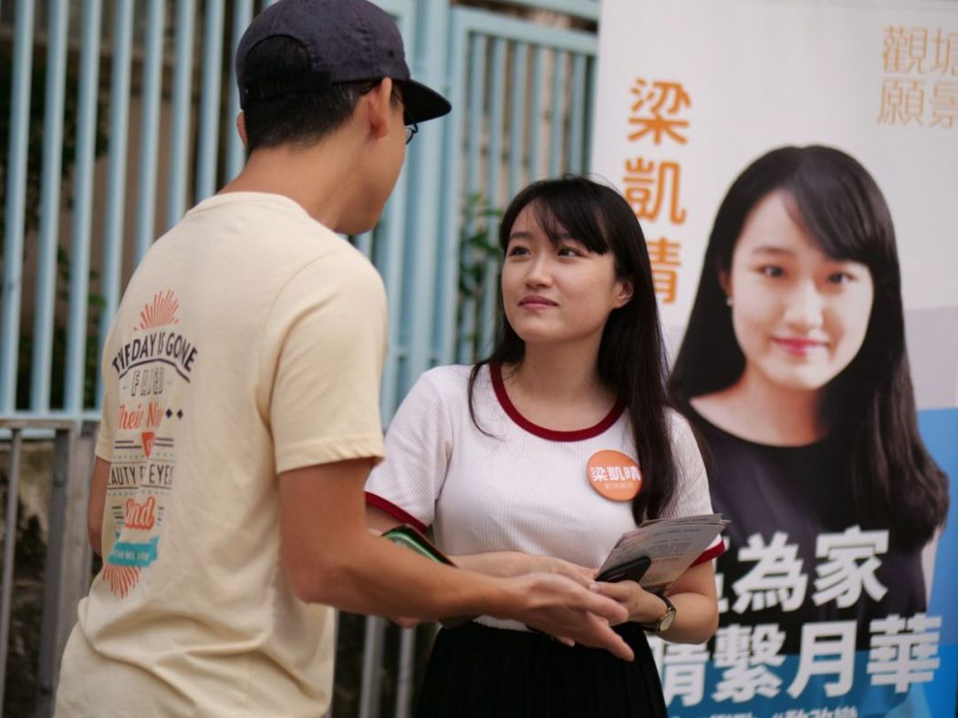
💀 ATTACKED BY MOB 💀
You start handing out flyers to community members in the evening, and when you are about to cross the street, you are hit in the back of your head with an unknown object. You are only able to see a bald man in a green polo shirt, but not his weapon.
You are one of several pro-democracy district council candidates who are attacked. Others have been “disqualified” from running for district council.
TRY AGAIN

Slide 57
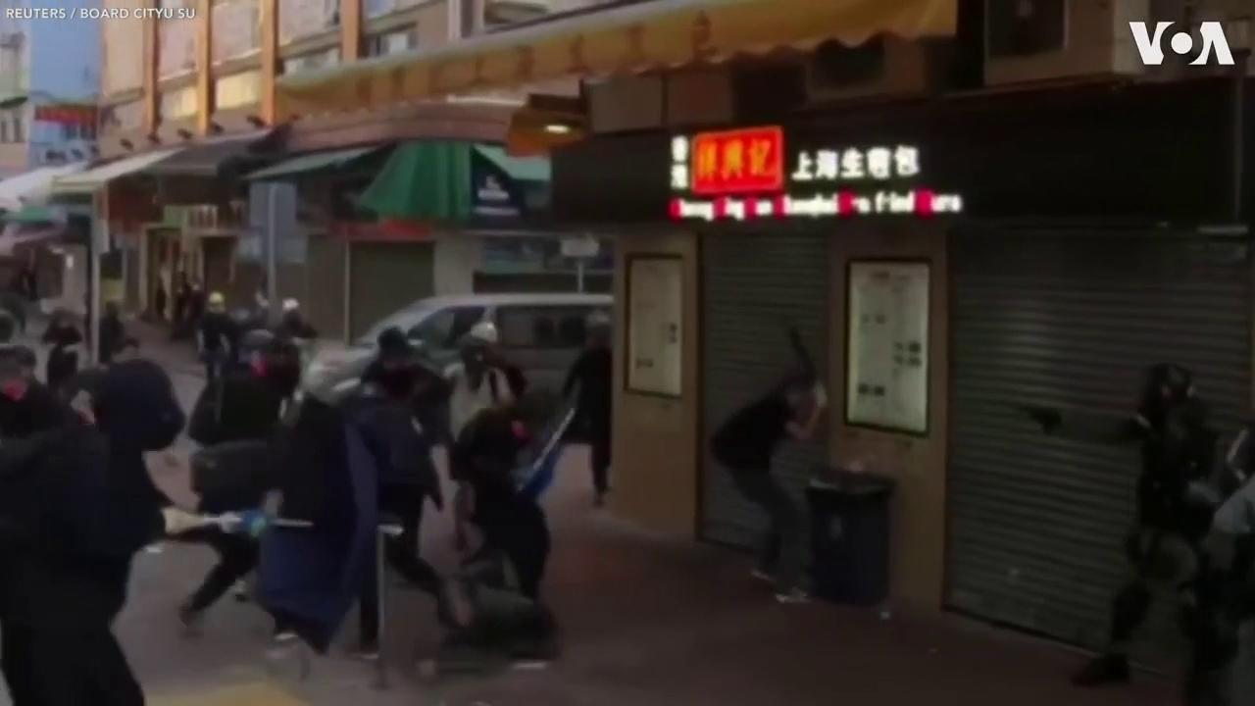
💀 NEAR-FATAL GUNSHOT 💀
You are shot in the chest by a police officer with actual bullets. The bullet is only 3cm from hitting your heart. No one offers you medical attention as you beg for help.
Police frames you further by replacing your plastic water pipe with a metal rod. You also get charged with assaulting the police as you struggle in the intensive care unit.
TRY AGAIN

Slide 58
Your story is not over...
Hong Kongers will continue to march the streets, and other victims will find courage to speak up for themselves and others.
The world supports you too!
US House of Reps has unanimously pass the HK Human Rights and Democracy Act of 2019
Amnesty International has condemned HK Police Force’s use of excessive violence
Norwegian PM has nominated HKers for the Nobel Peace prize
Tons of support from online, NBA fans, gamers...
...and you are not alone!
Notes:
The world will watch as Hong Kongers continue to find news ways to fight the regime, with the persistence and resourcefulness that once made them Asia’s financial hub, and a newfound solidarity and resilience born from hardship shared together.

Slide 59
A Note to the Player:
Many Hong Kongers long for the day democracy and justice are finally attained, and they can reunite with fellow protestors, unmasked.
This dream is what drives many onto the streets again and again. It is what drives donations, volunteer medics and carpools, and efforts to garner international support overseas.
Will you stand with them as they chase this dream?
“You may say I’m a dreamer
But I’m not the only one
I hope someday you’ll join us
And the world will live as one.”
Notes:
closing message

Slide 60

Thank you for playing!
Return to START

